Slide 1

Wealth Building and Planning for Retirement
(Updated June 2025)
Disclaimer: The information presented in this lesson does not constitute legal, tax, investment, financial, or other advice. This lesson is intended as an informational resource to assist you in identifying or exploring resources and options for managing your personal financial situation.

Slide 2
Agenda
Fundamentals of Saving and Investing
Account Types and Financial Goals
Planning for Retirement
Military Retirement Plans
Wealth Building and Planning for Retirement

Slide 3

Activity – What Would You Do with an Extra $50 per Week?
If you had an extra $50 per week, what would you choose to do with it?
Save it?
Invest it?
Spend it?
Wealth Building and Planning for Retirement

Slide 4
Saving Versus Investing
Saving
Investing
Accumulating money in an account that has little or no risk of losing value
Using money to purchase assets with the potential to increase in value over time
Time Frame
Risk
Liquidity
Rate of Return
Wealth Building and Planning for Retirement

Slide 5
Types of Savings Accounts
Savings Deposit Account
Money Market Savings Account
Certificates of Deposit (CDs)
Risk
Liquidity
Rate of Return
Wealth Building and Planning for Retirement

Slide 6
Key Investing Terms
Compound Interest
Inflation
Equities
Bonds
Mutual Funds
Dollar cost averaging
Diversification
Wealth Building and Planning for Retirement

Slide 7
Compound Interest and Inflation Overview
Compound interest is the eighth wonder of the world. He who understands it, earns it; he who doesn’t, pays it.”
- Albert Einstein
Wealth Building and Planning for Retirement

Slide 8
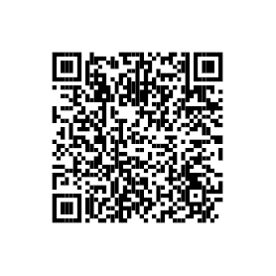
Compound Interest Examples
6% Scenario
Contribute (monthly contribution and number of years to save) – $200 for 20 years
Interest rate – 6%
Compound it — Annually
8% Scenario
Contribute (monthly contribution and number of years to save) – $200 for 20 years
Interest rate – 8%
Compound it — Annually
Scan here to access the interest calculator:
Wealth Building and Planning for Retirement

Slide 9
Scenarios in Action
Wealth Building and Planning for Retirement

Slide 10
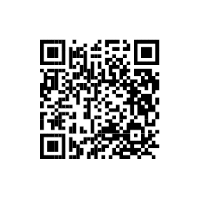
Inflation Example
Scan here to access the inflation calculator:
Wealth Building and Planning for Retirement

Slide 11



Types of Investments
Stocks
Bonds
Investment Funds
Wealth Building and Planning for Retirement

Slide 12

Stocks
Represent OWNERSHIP in a company
Risk
No money guarantee
Can lose some or all investment
Investment is NOT insured
Liquidity
Sell stocks at any time
Rate of Return
Potential to sell stock for a profit
Earn dividends
Depends upon company performance
Wealth Building and Planning for Retirement

Slide 13

Bonds
Risk
Low risk
Municipal bonds backed by the municipal tax authority
Corporate bonds riskier than government bonds
Liquidity
Sell bonds before their maturity date
U.S. savings bonds: EE and I series, visit https://treasurydirect.gov/
Rate of Return
Original purchase amount plus interest guaranteed at maturity
Corporate bonds tend to pay a higher interest rate than government bonds
Wealth Building and Planning for Retirement

Slide 14

Investment Funds
Risk
Considered lower risk than individual stocks because of diversification.
Level of risk aligns with the fund’s stated objectives.
Liquidity
Shares can be sold at any time.
Rate of Return
Projected rate of return depends on how the positions in the fund perform.
No guarantee of your investment or earnings.
Potential higher returns are associated with higher risk funds.
Wealth Building and Planning for Retirement

Slide 15
Investment Accounts
Qualified Account
Nonqualified Account
Tax treatment
Contributions and earnings
Example: Military TSP or civilian 401(k)
Contributions and earnings
Tax treatment
Example: Personal brokerage account professional or self-managed
Wealth Building and Planning for Retirement

Slide 16


Your Financial Goals and Account Considerations
Short-term Goals
Emergency fund
Vacation fund
Car or house downpayment
Long-term Goals
Retirement
Higher education
Wealth building
RISK – LIQUIDITY – TIME HORIZON
Wealth Building and Planning for Retirement

Slide 17
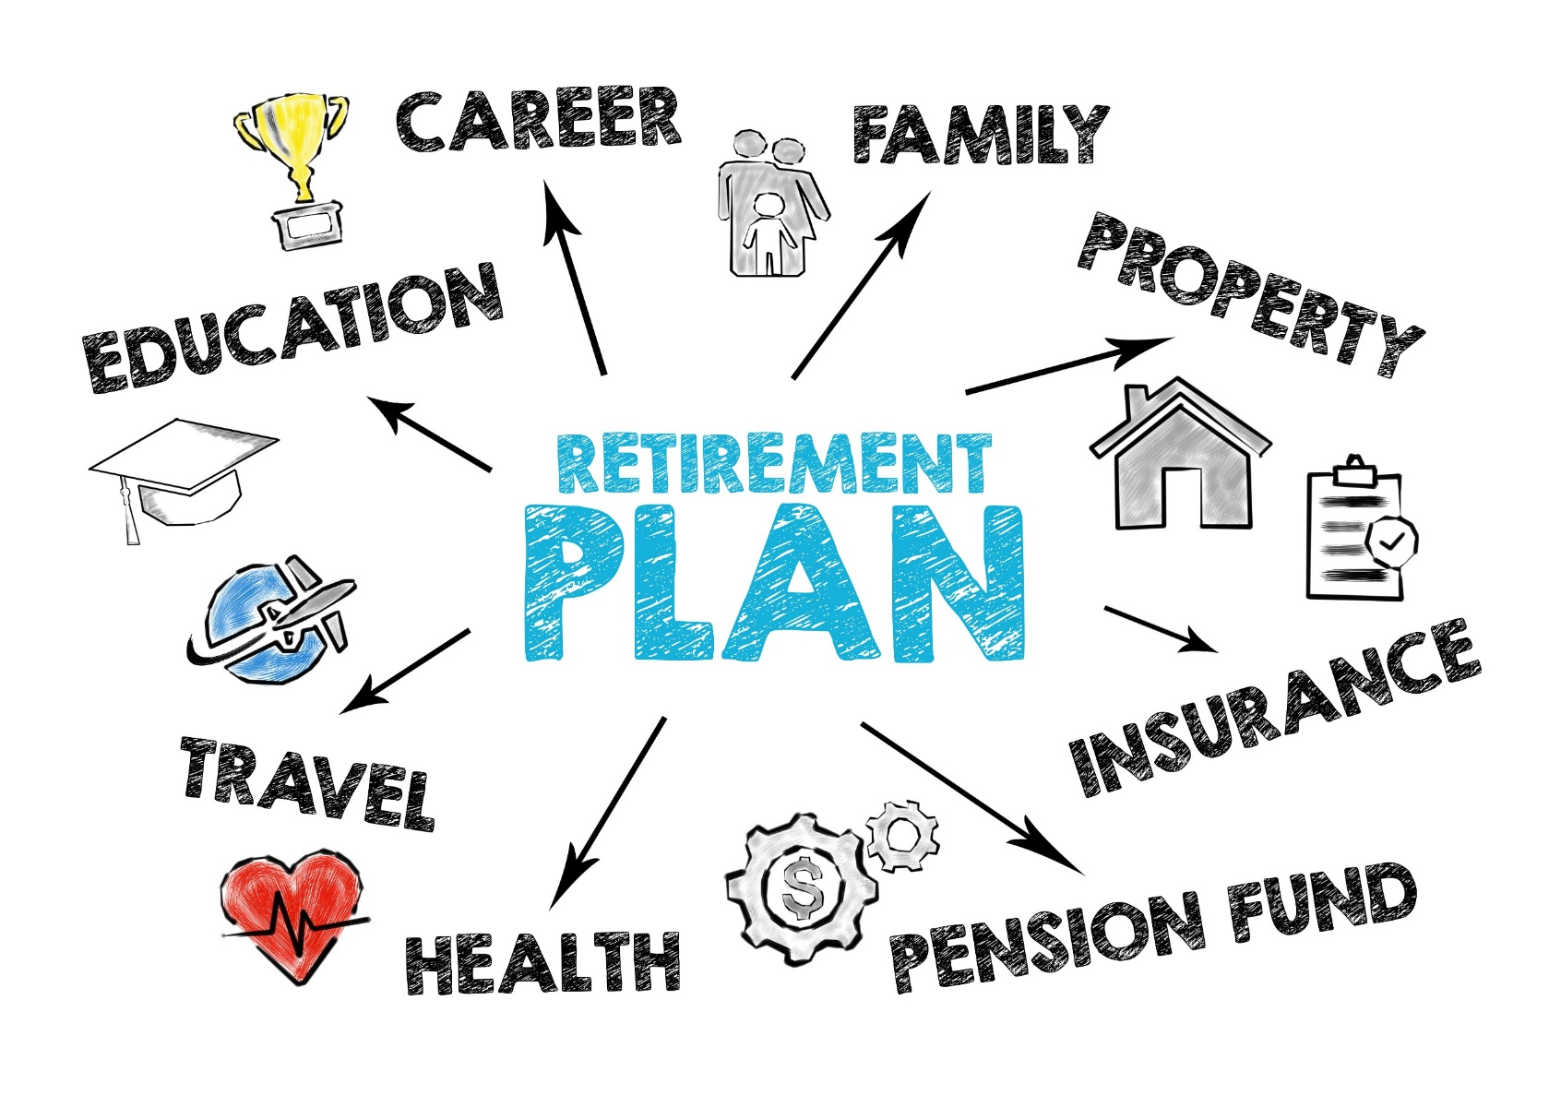
Activity: Building your Retirement Vision
Wealth Building and Planning for Retirement

Slide 18

Employer-sponsored Retirement Plans
Contributions
Withdrawals
Portability
Wealth Building and Planning for Retirement

Slide 19
Tax Treatment Options
Traditional
Roth
After-tax contribution
Pretax contribution
Tax on withdrawals (contributions and earnings)
No tax on qualified withdrawals
Required Minimum Distribution (RMD)
No Required Minimum Distribution (RMD)
Early withdrawal penalty before 59 ½ with possible tax consequences
Early withdrawal penalty, before 59 ½ with possible tax consequences
Wealth Building and Planning for Retirement

Slide 20

Thrift Savings Plan
Annual Contributions
Withdrawals
Traditional
  Roth
  Portability
  National Guard and Reserve Considerations
Wealth Building and Planning for Retirement

Slide 21


TSP – Investment Options
TSP Individual Funds:
C, F, G, I, S Funds
Lifecycle Funds
Mutual Fund Window
For comprehensive information, visit https://www.tsp.gov and select “Fund options”
Wealth Building and Planning for Retirement

Slide 22

Accessing your TSP
DoD myPay and Coast Guard Direct Access
Update and review percentage of pay contribution
Type (Traditional / Roth)
Update address
TSP.gov and TSP app
  View portfolio
  Manage investments
  Change investment allocation
  Review and update beneficiaries
  Lost or misplaced account number or password
Wealth Building and Planning for Retirement

Slide 23

Types of Individual Retirement Accounts (IRA)
Traditional and Roth IRA
Annual contributions
Withdrawals
For more information, including annual contribution limits, visit https://www.irs.gov
Wealth Building and Planning for Retirement

Slide 24
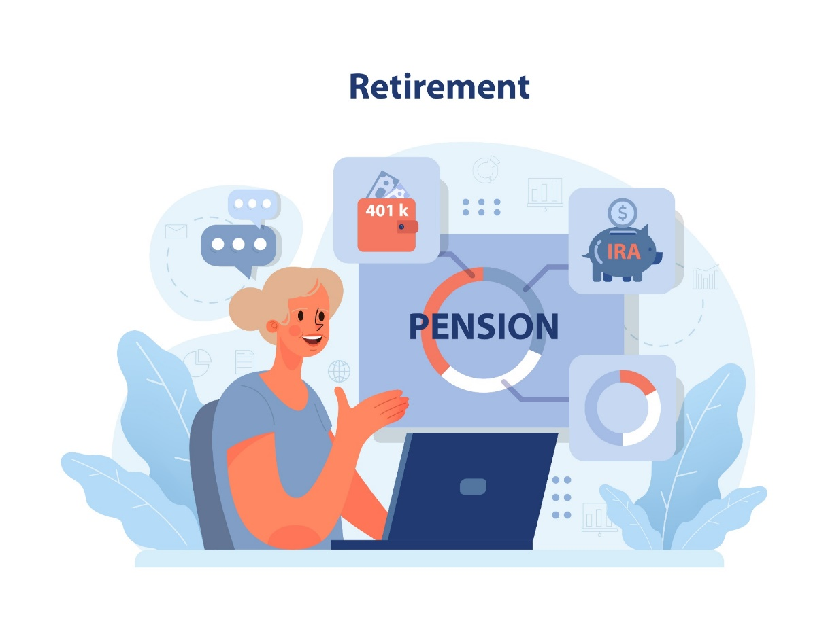
Sources of Retirement Income
Social Security
Pension Plans
Savings and Investment Income
Wealth Building and Planning for Retirement

Slide 25
Military Retirement System Overview
Blended Retirement System
Legacy Retirement System
Wealth Building and Planning for Retirement

Slide 26
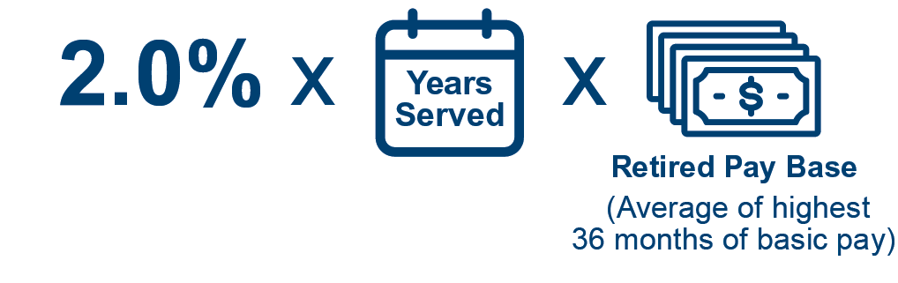
Blended Retirement System
Defined Benefit (Pension)
Defined Contribution (TSP)
Continuation Pay
Lump-sum Option
Wealth Building and Planning for Retirement

Slide 27
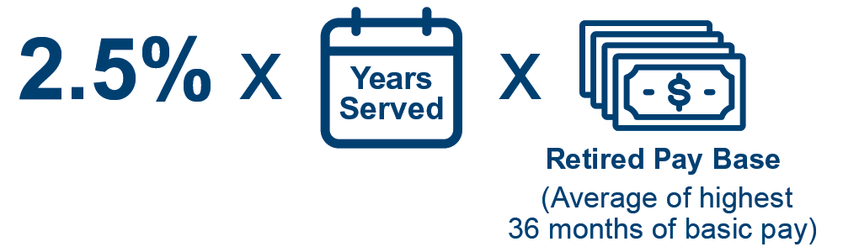
Legacy System Overview
Covers those who entered service before Jan. 1, 2018
Eligibility: Minimum of 20 years of qualifying service
Defined Benefit Calculation:
Wealth Building and Planning for Retirement

Slide 28

Survivor Benefit Plan
Monthly payment to designated beneficiary
Received after Service member’s/Retiree’s death
If retirees choose to participate in SBP, a monthly premium is deducted from retired pay
Wealth Building and Planning for Retirement

Slide 29

Additional Support and Assistance
Available Resources
  Personal Financial Manager, Personal Financial Counselors, or Financial Readiness Program Specialists at your local military and family support center
  Command/Unit Financial Specialist (USN, USMC, USCG)
  Installation legal office
  Military aid and relief societies
  Military OneSource
Wealth Building and Planning for Retirement

Slide 30

Conclusion
Fundamentals of Saving and Investing
Account Types and Financial Goals
Planning for Retirement
Military Retirement Plans
Wealth Building and Planning for Retirement

